Slide 1



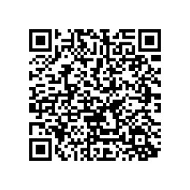
#MAKEMARCHCHATTY
This March 2026 we’re doing a feel-good fundraiser for The Chatty Café Scheme 💬☕️
Helping people connect, chat and feel less alone. Have a look below and join in if you can!
The Chatty Cafe Scheme relies on donations to help keep thousands of people connected. What may look like “just a table in a cafe” actually supports nationwide Chatter & Natter tables, telephone friendships, and online chats — all carefully coordinated, safeguarded, and supported by trained volunteers. 💛
To donate online, please use the QR code shown on the right.

